Slide 1
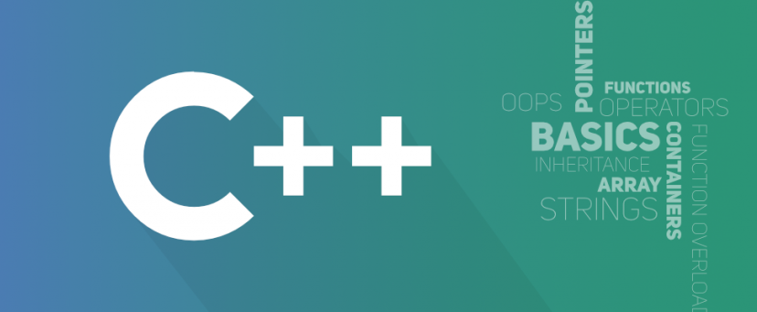
Object Oriented Programming
António J. R. Neves
DETI/UA
Sessão 6

Slide 2
Contents
Inheritance
Pointers
Virtual functions
Polymorphism
Abstract classes
Interfaces

Slide 3
Inheritance
Inheritance is probably the most powerful feature of object-oriented programming, after classes themselves
Inheritance is the process of creating new classes, called derived classes, from existing or base classes
The base class is unchanged by this process
Its big payoff is that it permits code reusability - once a base class is written and debugged, it need not be touched again, but, using inheritance, can nevertheless be adapted to work in different situations
Reusing existing increases a program’s reliability and help in the original conceptualization of a programming problem, and in the overall design of the program.

Slide 4
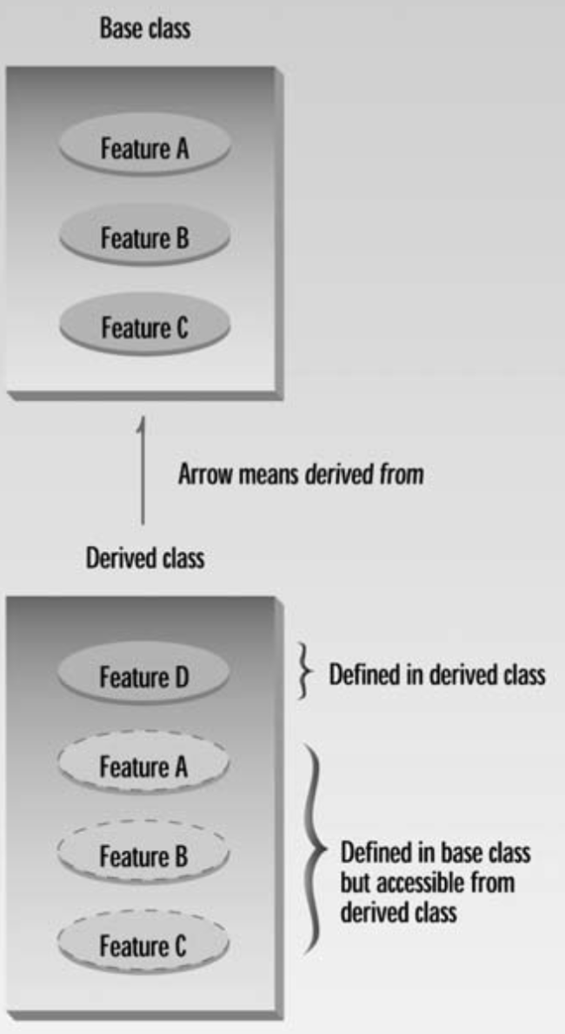
Inheritance relationship
The derived class inherits all the capabilities of the base class but can add embellishments and refinements of its own
In a class diagram, the more common approach is to point the arrow up, from the derived class to the base class

Slide 5
Base and Derived Classes
A class can be derived from more than one class, which means it can inherit data and functions from multiple base classes
To define a derived class, we use a class derivation list to specify the base class(es)
A class derivation list names one or more base classes and has the form
class derived-class: access-specifier base-class
The access-specifier is one of public, protected, or private, and base-class is the name of a previously defined class
If the access-specifier is not used, then it is private by default

Slide 6
Access Control
Public Inheritance - public members of the base class become public members of the derived class and protected members of the base class become protected
Protected Inheritance - public and protected members of the base class become protected
Private Inheritance - public and protected members of the base class become private
A derived class can access all the non-private members of its base class. Thus base-class members that should not be accessible to the member functions of derived classes should be declared private in the base class.
A derived class inherits all base class methods with the following exceptions: constructors, destructors copy constructors, overloaded operators and friend functions of the base class

Slide 7
Example
// Base class class Shape { public: void setWidth(int w) { width = w; } void setHeight(int h) { height = h; } protected: int width; int height; }; | // Derived class class Rectangle: public Shape { public: int getArea() { return (width * height); } }; int main(void) { Rectangle Rect; Rect.setWidth(5); Rect.setHeight(7); // Print the area of the object. cout << "Total area: " << Rect.getArea() << endl; return 0; }

Slide 8
Example 2
// Base class Shape class Shape { public: void setWidth(int w) { width = w; } void setHeight(int h) { height = h; } protected: int width; int height; }; // Base class PaintCost class PaintCost { public: int getCost(int area) { return area * 70; } }; | // Derived class class Rectangle: public Shape, public PaintCost { public: int getArea() { return (width * height); } }; int main(void) { Rectangle rect; int area; rect.setWidth(5); rect.setHeight(7); area = rect.getArea(); cout << "Total area: " << rect.getArea() << endl; cout << "Total paint cost: $" << rect.getCost(area) << endl; return 0; }

Slide 9
Constructors
When we create an object from the derived class, the compiler will substitute a no-argument constructor from the base class
If we need a constructor with arguments, we have to declare them using the following syntax:
// Base class class Shape { private: int width; int height; public: Shape(int, int); }; | // Derived class class Rectangle: public Shape { public: Rectangle(int, int); } // .cpp Rectangle::Rectangle(int w, int h): Shape(w, h){ ... }

Slide 10
Overriding Member Functions
We can use member functions in a derived class that override—that is, have the same name as—those in the base class
We might want to do this so that calls in your program work the same way for objects of both base and derived classes
When the same function exists in both the base class and the derived class, the function in the derived class will be executed - this is true of objects of the derived class
Objects of the base class don’t know anything about the derived class and will always use the base class functions
We say that the derived class function overrides the base class function

Slide 11
Pointers
Consider a base class and a derived classes with functions with the same name, and we want to access these functions using pointers:
Derv1 dv1; //object of derived class 1
Derv2 dv2; //object of derived class 2
Base* ptr; //pointer to base class
ptr = &dv1; //put address of dv1 in pointer
ptr->show(); //execute show()
ptr = &dv2; //put address of dv2 in pointer
ptr->show(); //execute show()
Which of the show() functions is called here?
The function in the base class is always executed since the compiler ignores the contents of the pointer ptr and chooses the member function that matches the type of the pointer
Sometimes we do not want this...

Slide 12
Virtual Functions
Virtual means existing in appearance but not in reality
When virtual functions are used, a program that appears to be calling a function of one class may in reality be calling a function of a different class
Used for: Suppose you have a number of objects of different classes but you want to put them all in an array and perform a particular operation on them using the same function call
For example, suppose a graphics program includes several different shapes: a triangle, a circle, a square, and so on - each of these classes has a member function area() that returns the area of the object
Suppose you want to manage a number of these elements together, and you want to calculate the area of them

Slide 13
Pure virtual function
A pure virtual function is one with the expression =0 added to the declaration
The equal sign here has nothing to do with assignment - this syntax is simply how we tell the compiler that a virtual function will be pure
If you attempt to create objects of class Base, the compiler will complain that you are trying to instantiate an object of an abstract class
Once you’ve placed a pure virtual function in the base class, you must override it in all the derived classes from which you want to instantiate objects
If a class doesn’t override the pure virtual function, it becomes an abstract class itself, and you can’t instantiate objects from it

Slide 14
Polymorphism
This is an interesting capability: completely different functions are executed by the same function call
If the object is a circle, the function that calculates the area of a circle is called; if it is a triangle, the triangle-area function is called, and so on
This is called polymorphism, which means different forms.
The functions have the same appearance, the area() expression, but different actual functions are called, depending on the object
Polymorphism is one of the key features of object-oriented programming, after classes and inheritance

Slide 15
Polymorphism
For the polymorphic approach to work, several conditions must be met:
all the different classes of shapes, such as circles and triangles, must be descended from a single base class (ex. Figure)
the draw() function must be declared to be virtual in the base class
Figure.h
…
virtual double area() = 0;
Rectangle.h … double area(); | Rectangle.cpp … double Rectangle::area(){ return w * h; }

Slide 16
Abstract Classes
Think of the Figure class in the previous example - we will never make an object of the Figure class - we will only make specific Figures such as circles and triangles
When we will never want to instantiate objects of a base class, we call it an abstract class
Such a class exists only to act as a parent of derived classes that will be used to instantiate objects
We can do that placing at least one pure virtual function in the base class

Slide 17
Interfaces
Abstract classes cannot be used to instantiate objects and serves only as an interface for the class hierarchy.
Attempting to instantiate an object of an abstract class causes a compilation error.
An interface describes the behavior or capabilities of a class without committing to a particular implementation of that class.
Thus, if a subclass of a base class needs to be instantiated, it has to implement each of the virtual functions, which means that it supports the interface declared by the base class.
Failure to override a pure virtual function in a derived class, then attempting to instantiate objects of that class, is a compilation error.

